Slide 1
Designing an Effective Power Draw Measurement Device
Edgar Guzman, eiguzman@ucsd.edu

Slide 2
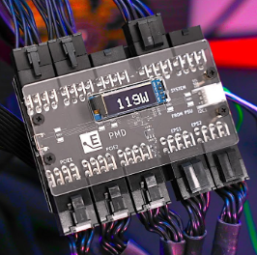
Vision / Motivation
Design an effective measurement device for power delivery in desktop computers
The goal is to graph power draw (in Watts) over time during a GPU stress test to detect anomalies/spikes in power draw.
Socket PDMs exist, but only measure wall power draw
Shunt mods for computer components exist, but at the risk of breaking warranties.
Without proper circuit configuration, failures can cost from $30 upwards to thousands of dollars in desktop components.

Slide 3
Outline / IoT integration
Integrating the following sensors:
Hall-effect sensors/shunt resistors (INA219 for low power applications)
Current, voltage, and Power sensors (INA260), allowing for measurable electric signals.
To prevent damage to high-value components, use 10-15A fuses.
LCD / OLED screen for real-time data accessibility
Transfer data to desktop via USB
Buzzer module used for warning, signaling high current
To process data locally, Bluetooth modules can transmit data without interference from other WiFi signal users.
Use data science tools to create graphs or implement desktop applications to do this automatically after tests.

Slide 4
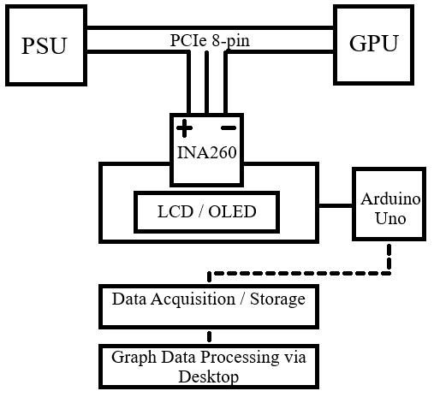
Flowchart
GPU draws power from PSU
Power rerouted to INA260 via modified PCIe cable
Arduino reads power draw from INA260 via I2C
Sampling rate logs total power draw in Watts
Data sent to desktop for time-series graphing

Slide 5
Timeline
 | W1 | W2 | W3 | W4 | W5 | W6
Hardware Design
Circuit validation
Data Gathering
Model Training
Validation

Slide 6
Components
Arduino Uno microcontroller
Current/Voltage/ Power sensors (INA260)
LCD / OLED display
PCIe 12v 8-pin Connector, M to F
Connecting wires/ breadboard/ PCB
USB, microcontroller to Desktop
Failsafe: 10-15A Fuse

Slide 7
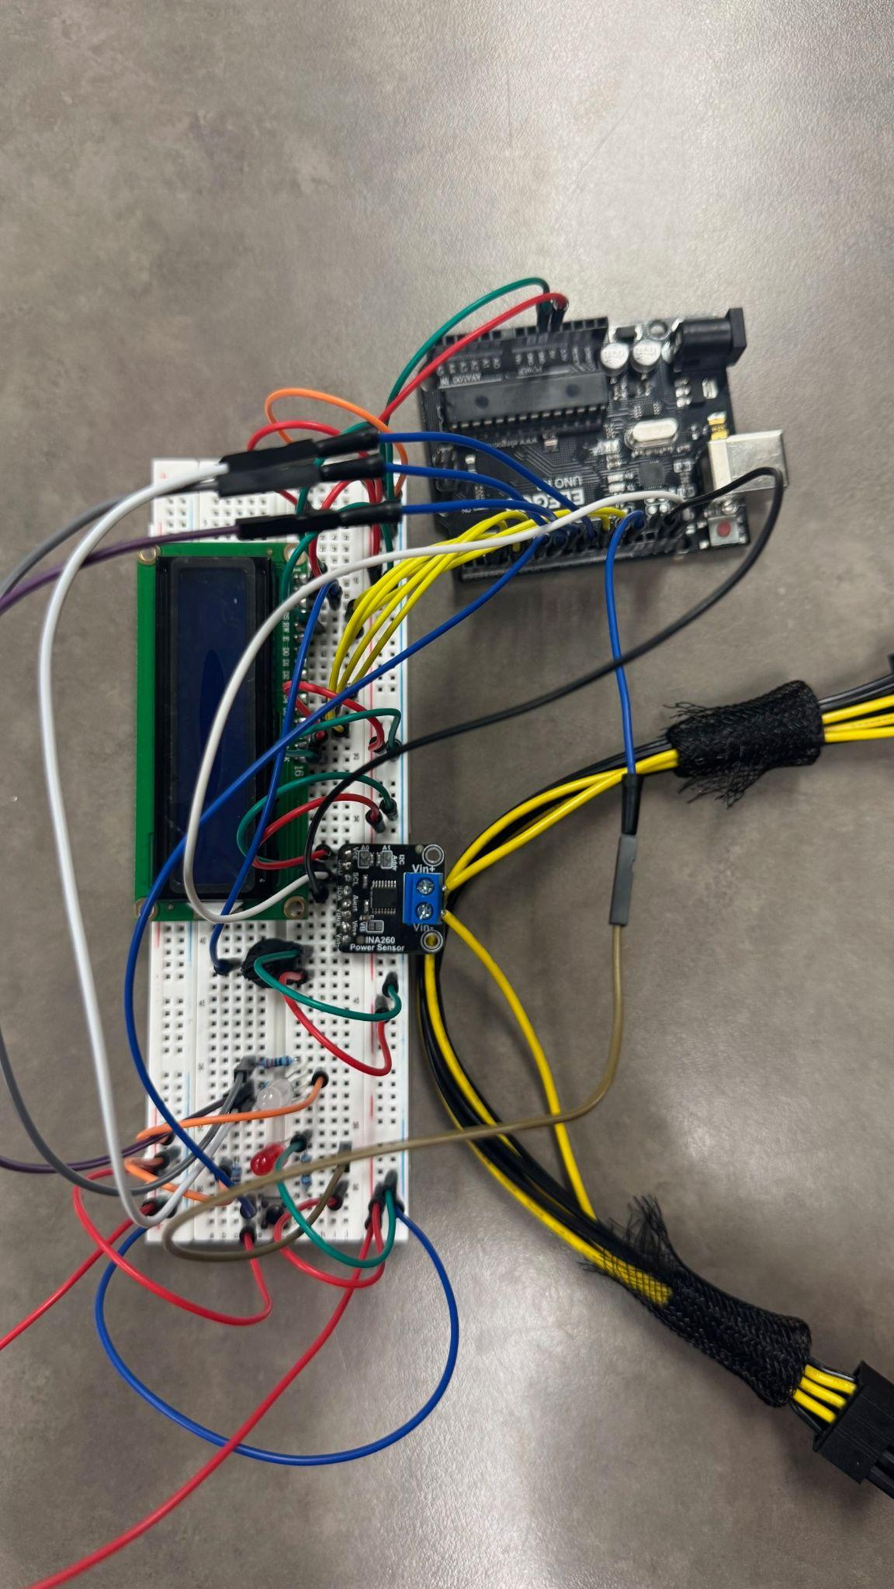
PowerPulse - A Power Draw Measurement Device for Desktop GPUs
Edgar Guzman, eiguzman@ucsd.edu

Slide 8
Vision / Motivation
Design an effective measurement device for power delivery in desktop computers
The goal is to graph power draw (in Watts) over time during a GPU stress test to detect anomalies/spikes in power draw.
Socket PDMs exist, but only measure wall power draw
Shunt mods for computer components exist, but at the risk of breaking warranties.
Without proper circuit configuration, failures can cost from $30 upwards to thousands of dollars in desktop components.

Slide 9
Outline / IoT integration
Integrating the following sensors:
INA260 For Voltage, Current, and Power monitoring
LCD screen for real-time data accessibility
Potentiometer for screen dimming
Green LED -Power on
Red LED - Flashing Warning; Danger threshold monitor
Button and RGB LED - Mode switcher
PCIe Extension cable to connect to PSU
Data collection via USB serial ports to laptop

Slide 10
Flowchart
GPU draws power from PSU
Power rerouted to INA260 via modified PCIe cable
Arduino reads power draw from INA260 via I2C
Sampling rate logs voltage, current, and power draw
Data sent to desktop for time-series graphing

Slide 11
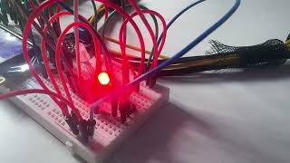
Video Link
https://youtu.be/Fu2_qmyn0Wg

Slide 12
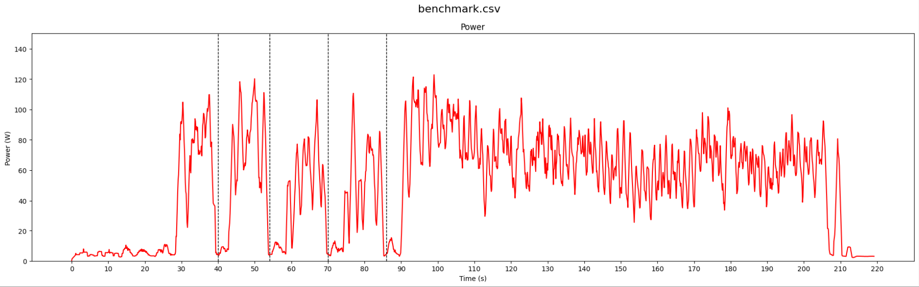
Anomaly Detection - Rolling Average smoothing

